Slide 1
Mr. Thrift’s
Science Class
2024-2025

Slide 2
Entering Class
Read the promethean board
GET OUT ALL YOUR MATERIALS
Sharpen all pencils (No Pens in class)
Work on the warm-up
No loud talking
Finish all materials given

Slide 3
During Class (Teacher Directed)
Stay in your seat
Respect the person who is talking
Raise your head to be called on
Do not distract others
Pay Attention

Slide 4
During Class (Independent Work)
If you need to put something in the trashcan, get up and do so.
If you need to sharpen your pencil, get up and do so.
Do not talk to other groups or move around to talk to other people without permission.

Slide 5
During Labs/Group Work
Obey Lab Safety procedures
No Horse Play
If you make a mess, clean it up!
Don’t bother others in another group.
Everyone must participate

Slide 6
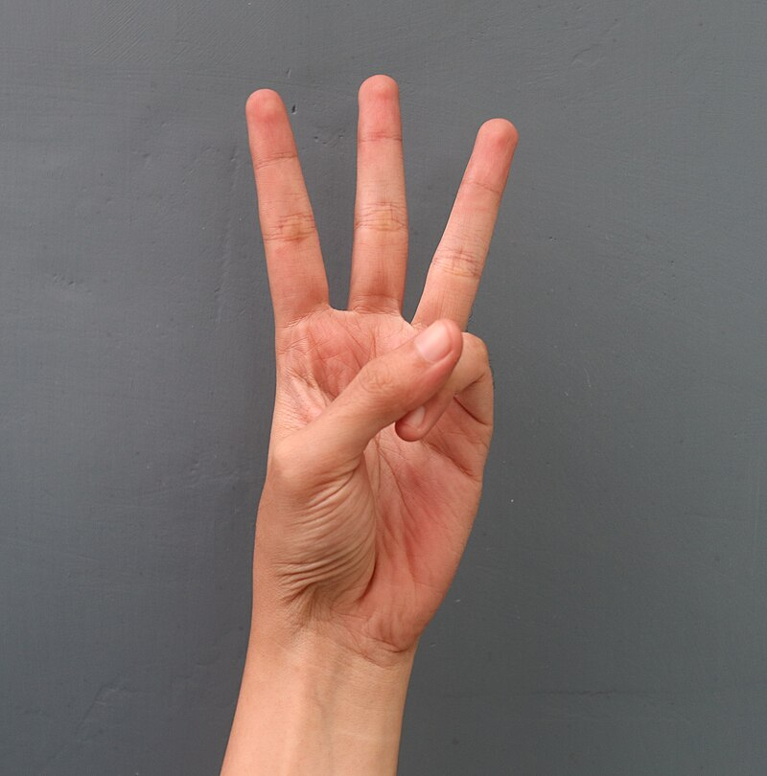
Give Me 3
Stop what you're doing
Look at me
Listen to directions
This Photo by Unknown author is licensed under CC BY-SA.

Slide 7
Let's do our Up's
Pack up your stuff
Clean up your Area
Stand up behind your desk
This Photo by Unknown author is licensed under CC BY-NC.

Slide 8
Lab Rules and Expectations
No Horse Play
No walking around to talk to other people
If you break something, let Mr. Thrift know
Do no talk to people in other groups
Do not run around
Clean up after yourself
Make sure your group members are on task at all times.
Failure to follow directions will lead to you being removed from a lab or labs for the rest of the year.

Slide 9
Exiting Class
Collect all your materials
You will not be allowed back to my room
Exit ASAP, don’t wait on your friends
Go directly to your next class or waiting area, do not go to the restroom
I will not permit you to go to the restroom at the end of my class.

Slide 10
Exiting Class (Temp School Only)
We will exit out the back door of the room.
You will line up along the wall next to my front door.
The other class will enter as you wait for class change, when all is clear you will Move to the next classroom
All hallway behaviors will be monitored, All hallway expectations will be followed.

Slide 11
Do's and Don'ts of Temp School
Keep Windows Closed at all times
Watch your step in Mr. Thrift's Classroom.

Slide 12
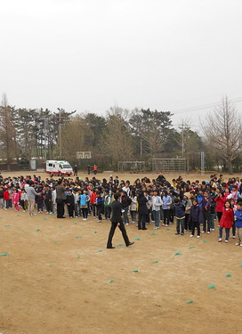
Fire Drill
Stop what you are doing
Line up at the front of the classroom.
No talking; wait for directions
Go directly to the assigned location
No pushing or shoving
ThePhoto by PhotoAuthor is licensed under CCYYSA.

Slide 13
Lock Down
Stop working
No Talking
Follow all directions given
Minimal Moving
Wait for directions from Mr. Thrift

Slide 14
Computer Expectations
You will be only on the website I provide
You are assigned a computer
If the computer is messed up, report it
Only use the Chromebook assigned to you
If you are caught using the computer incorrectly, I will remove the computer from you.

Slide 15
Restroom
No passes during the first 15 minutes or last 15 minutes of class.
You must sign out to go to the restroom
You must have a pass to the restroom

Slide 16
Cell Phones
Belair K-8 Rules say “NO Cell Phones”
First offense, warning and call home
Second, Mrs. Lambert, Mrs, Crawford, or Ms. Sturgis will be contacted. Your phone will be removed, and you will be asked not to bring one to school any more.

Slide 17
Hall Pass
No Passes to Other Classes
Only Passes to the councilor. If you make arrangements and they come to get you.
No Passes to the Nurse without an escort
No passes to the office without an escort

Slide 18
Professional Language
Here at Belair, we use professional Language.
Everything played must be radio edition.
If it cannot be played on the radio, it cannot be played in my classroom.
Constant use of colorful language will lead to a write up.

Slide 19
Minor Grades 60%
Class Assignments
Must be completed in the class time
Homework
Due when you return
You have up to 2 days after it is due to turn in work. I count off 10% each day it is late.

Slide 20
Formal Grading 40%
This will include any assignments that are unit tests, labs that are told to be formal, and Mid unit Quizzes.

Slide 21
Assignment Collection
Paper Assignments are to be turned in to the classwork bin
I will not accept things by hand
Electronic is due in canvas and not by email.
IF an assignment is late I will grade it as such

Slide 22
Absence from Class
It is your responsibility to complete all work missed in class
I will not come to find you to tell you what you are missing.
I will not come to find you when you miss.

